Slide 1
Leveraging Technology to Better Manage Your Ethics Program
Elizabeth Horton
March 9, 2016

Slide 2

Leveraging Technology to Better Manage Your Ethics Program
Overall Objective:
To Modernize the Retention and Retrieval of Advice, Filing and Training Records

Slide 3
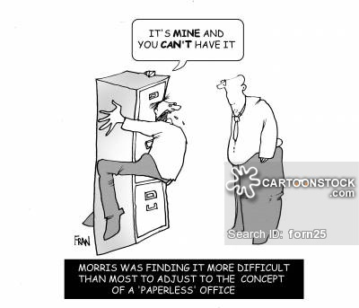
Leveraging Technology to Better Manage Your Ethics Program
Change can have its downsides:

Slide 4

Leveraging Technology to Better Manage Your Ethics Program
But it also has its upsides:
Morris can now immediately find the information he was looking for.

Slide 5
Leveraging Technology to Better Manage Your Ethics Program
Treasury’s Ethics Tracker
  Advice Archive
  Program Management Tools
  Automated Confidential Filing

Slide 6
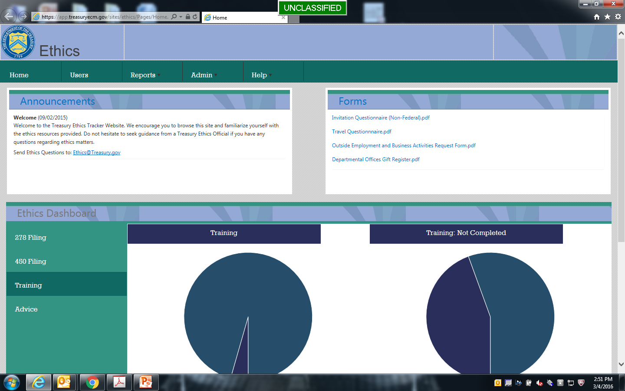
Leveraging Technology to Better Manage Your Ethics Program

Slide 7
Leveraging Technology to Better Manage Your Ethics Program
Advice Archive:
  Provides a chronological record of advice attached to each employee record.
  Can be used to record analysis/advice concerning invitations, non-federal source travel, outside activities and conflicts.
  The advice archive can be sorted/searched within each employee record or as part of a larger advice report.

Slide 8
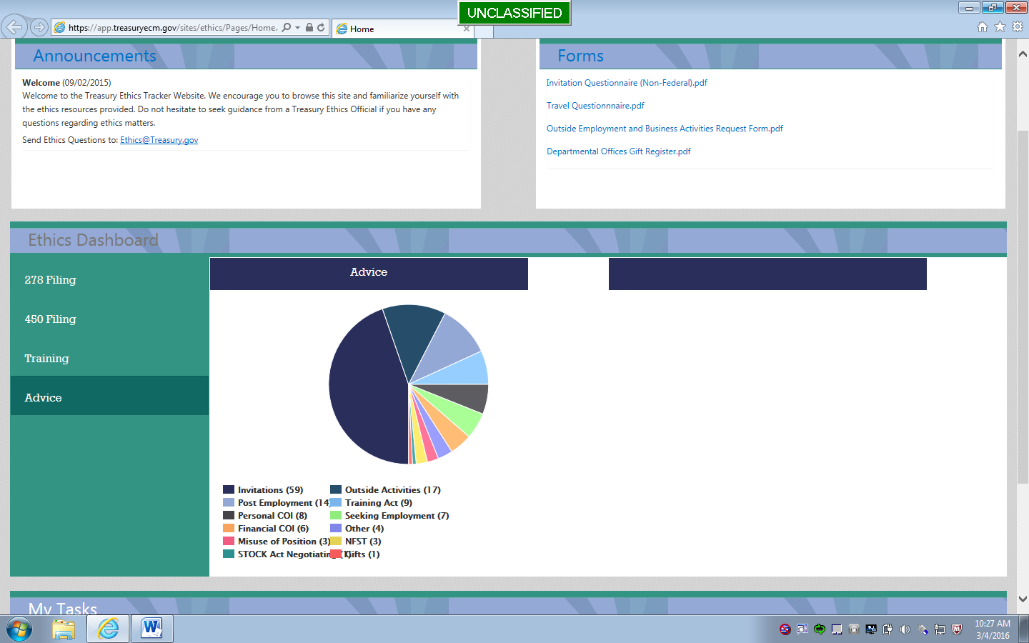
Leveraging Technology to Better Manage Your Ethics Program

Slide 9
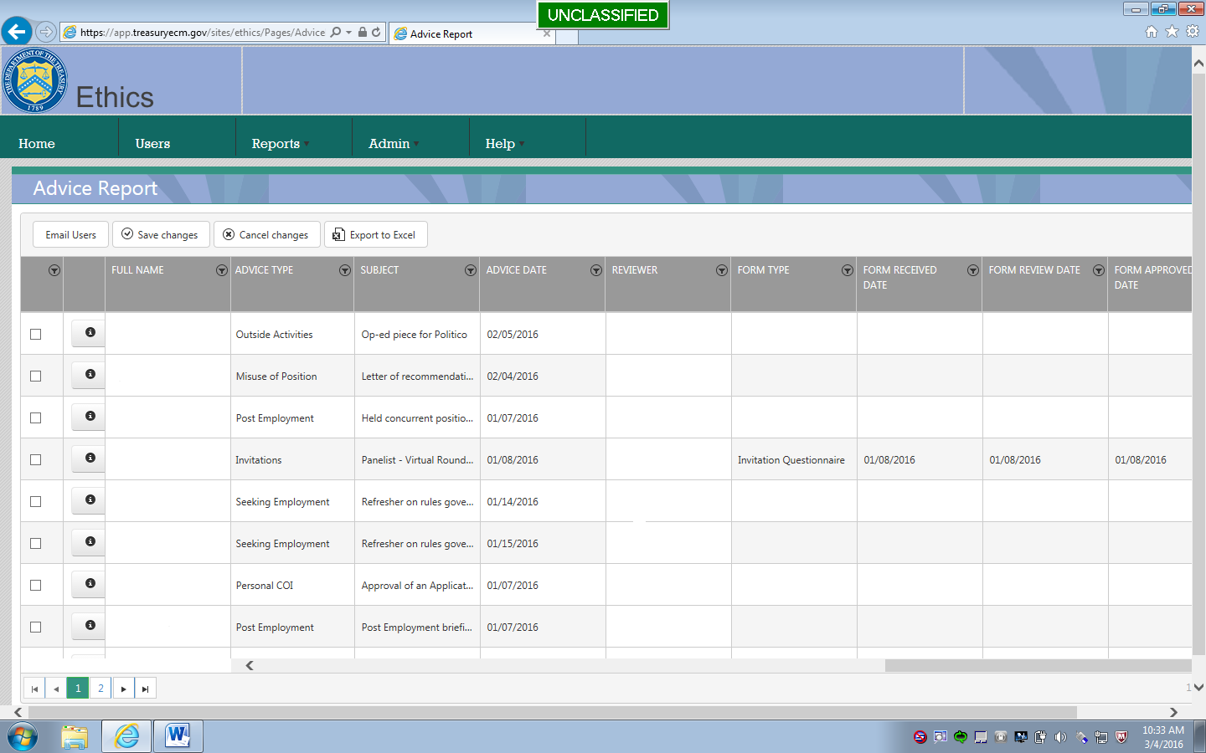
Leveraging Technology to Better Manage Your Ethics Program

Slide 10
Leveraging Technology to Better Manage Your Ethics Program
Program Management Tools:
  Reports: Can be sorted using a wide range of data. This enables the team to produce very specific reports concerning training, advice and financial disclosure.
  Dashboards: Provides management with real-time information regarding the status of filing and training.
  Team Wiki Page: Enables collaboration and maintains continuity on selected topics.

Slide 11
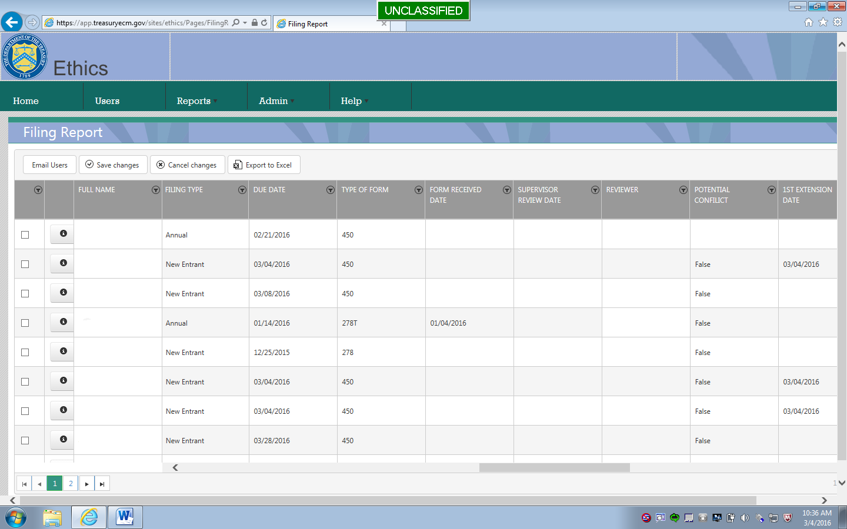
Leveraging Technology to Better Manage Your Ethics Program

Slide 12
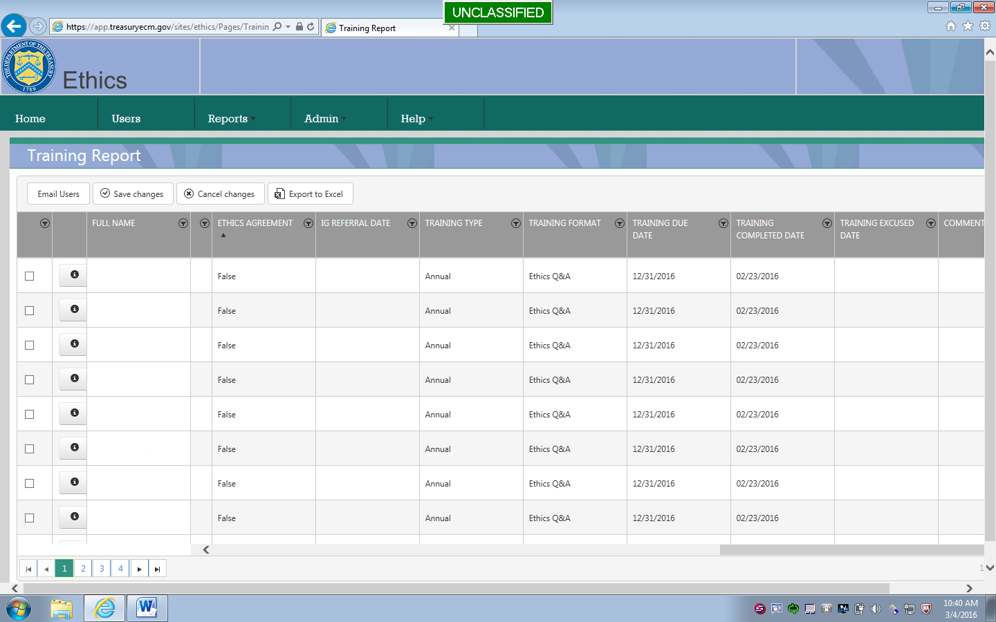
Leveraging Technology to Better Manage Your Ethics Program

Slide 13
Leveraging Technology to Better Manage Your Ethics Program
Automated Confidential Filing:
  Provides a paperless (and therefore more streamlined and more secure) process for New Entrant and Annual OGE 450s.
  Allows filers to populate forms with data from the previous year.
  Data from the filing system is immediately available through reports and dashboards, creating an accurate picture of filing status throughout Departmental Offices (headquarters).
  Filers can begin the filing process via the personalized dashboard on the ethics homepage.

Slide 14
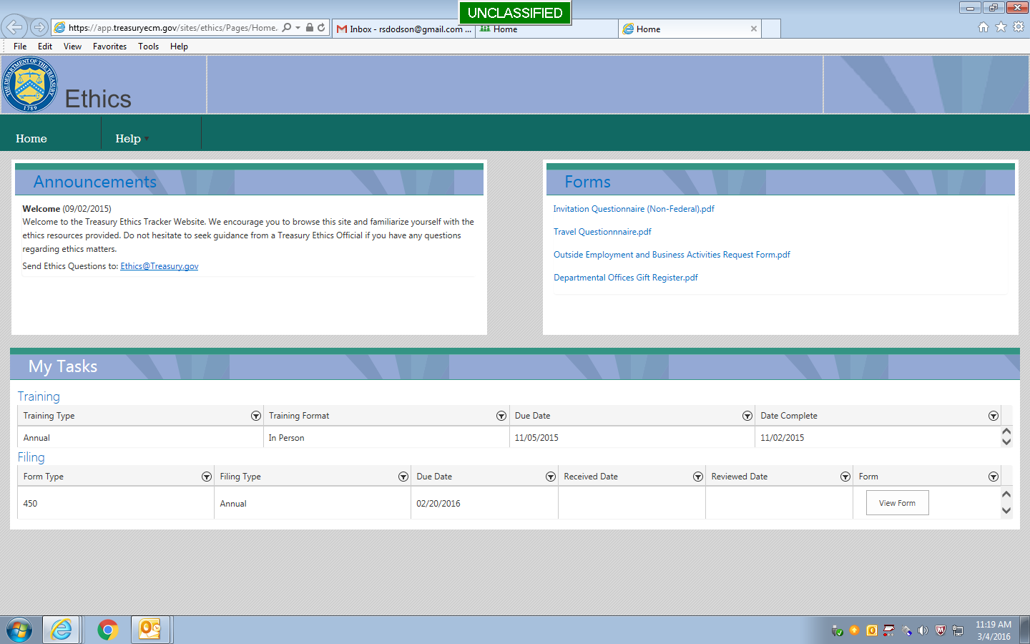
Leveraging Technology to Better Manage Your Ethics Program

Slide 15
Leveraging Technology to Better Manage Your Ethics Program
Elizabeth Horton
Deputy Assistant General Counsel (Ethics)
Department of the Treasury
202-622-9794
elizabeth.horton@treasury.gov

